Slide 1

TITLE
Sales Data Analysis Using Python
Project Created By : Dhruv Balasaheb Dhere
Internship Company : Puneri Pattern
Date : 28th Feb 2026
College : Trinity Academy of Engineering ,Pune

Slide 2

Problem Statement :
Evaluate total revenue generated .
Analyze daily and monthly sales trends.
Identify peak performance periods.
Determine the best-performing product line.
Provide actionable business insights.

Slide 3
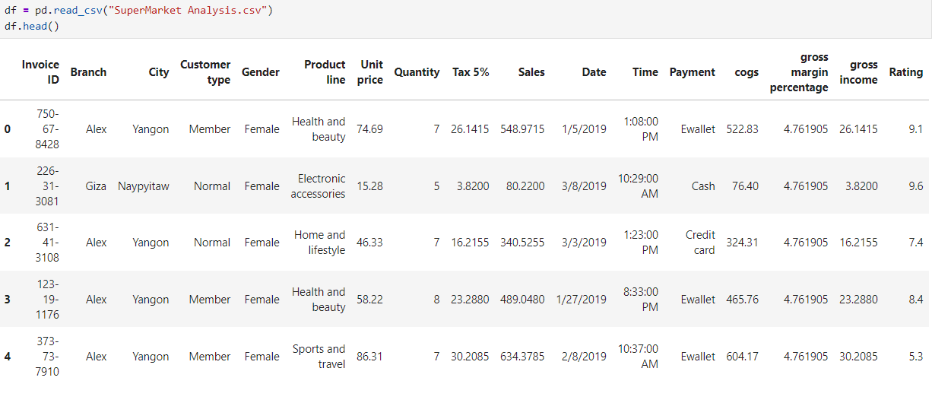
Data Set Overview :
The dataset contains supermarket sales transaction records.
It includes information about product lines, sales amount, quantity, branch, and payment method.
Each row represents an individual sales transaction.
The dataset was used to analyze revenue trends and product performance.
📄 Total Records: 1000 rows
📊 Total Features: 17 columns
🏬 Data Type: Transaction-level retail sales data

Slide 4

Tools And Technologies
Used :
Python – Core programming language used for analysis
Pandas – Data manipulation and aggregation (groupby, sum, etc.)
NumPy – Numerical operations
Matplotlib – Basic data visualization
Seaborn – Advanced and attractive visualizations
Jupyter Notebook (Anaconda) – Development environment

Slide 5
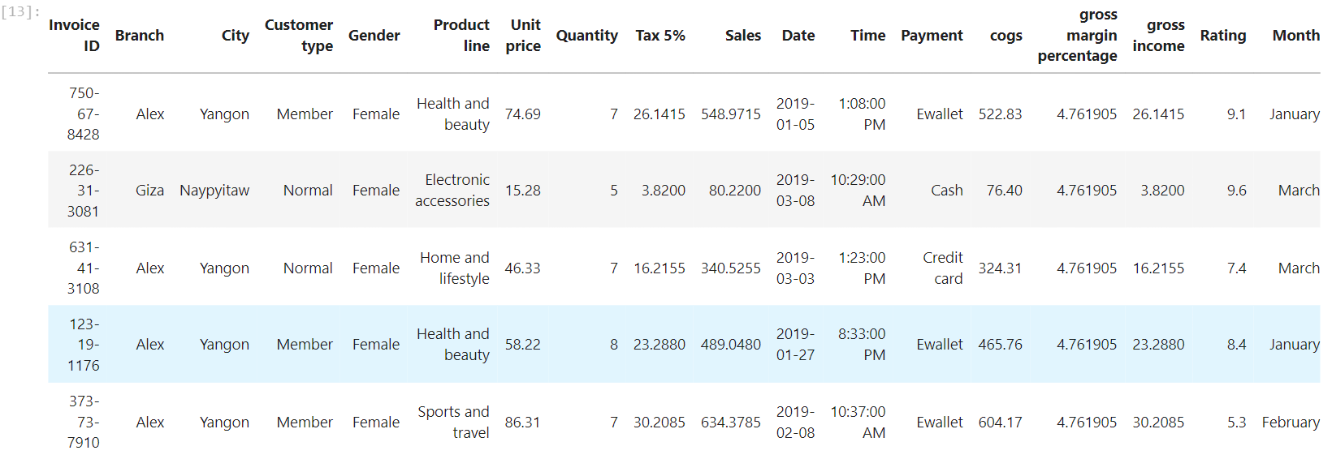
Data Cleaning And Preparation :
Checked dataset structure using df.info()
Verified missing values and data types
Converted Date column into datetime format
Extracted Month from Date for monthly analysis
Structured data for time-based aggregation

Slide 6
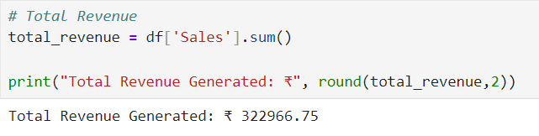
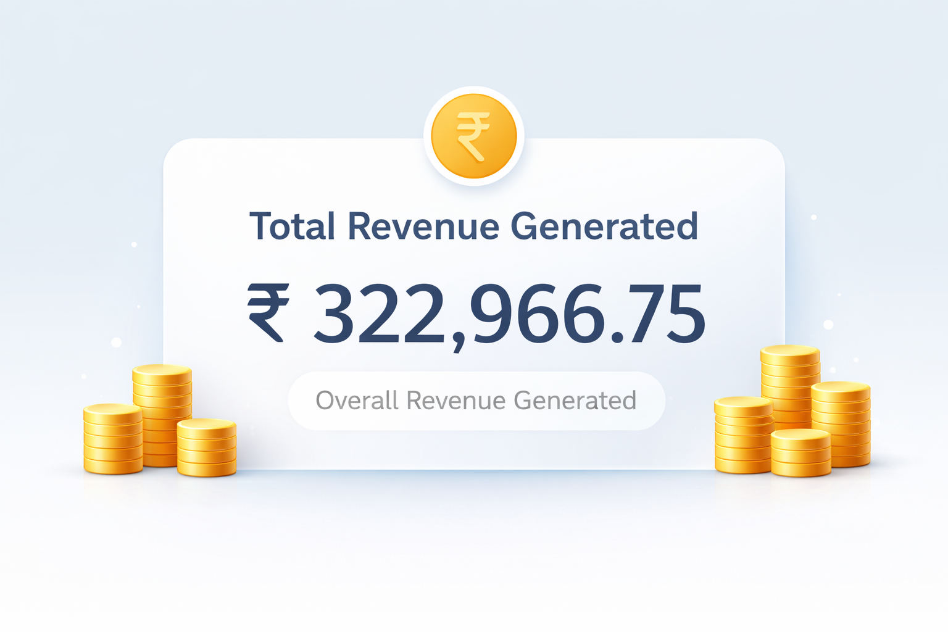
Total Revenue Analysis:
Calculated total revenue generated during the selected time period.
Aggregated all sales transactions to measure overall business performance.
Total revenue provides a high-level view of financial performance.

Slide 7
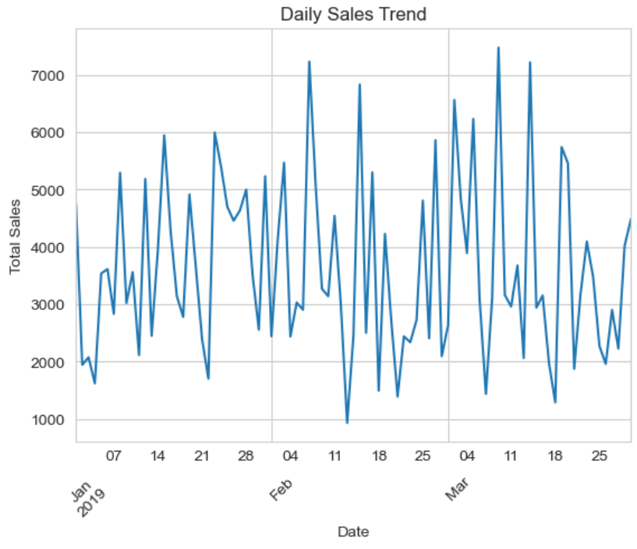
Daily Sales Trend Analysis :
Sales revenue varies significantly across days.
Multiple peak revenue days were observed during the period.
Fluctuations indicate possible promotional or seasonal effects.
Time-series analysis helps in identifying demand patterns.

Slide 8
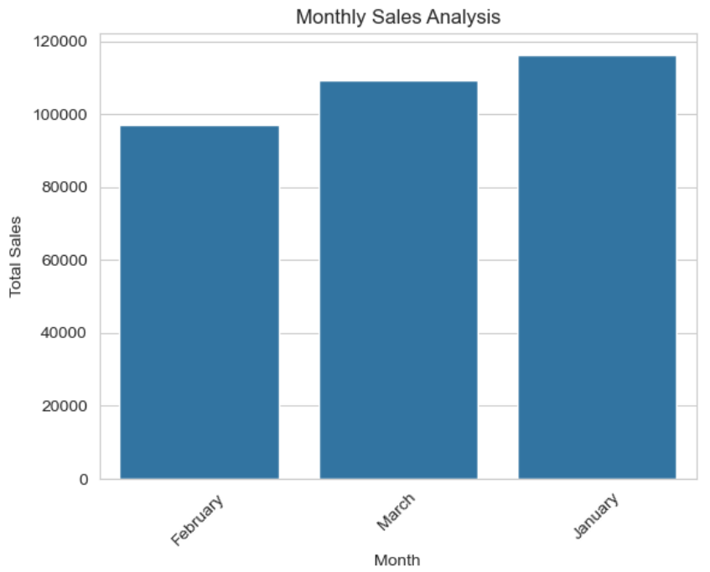
Monthly Sales Performance:
Aggregated sales data on a monthly basis.
Compared revenue performance across January, February, and March.
Identified the highest and lowest performing months.
Monthly analysis helps detect seasonal patterns and revenue growth trends.

Slide 9
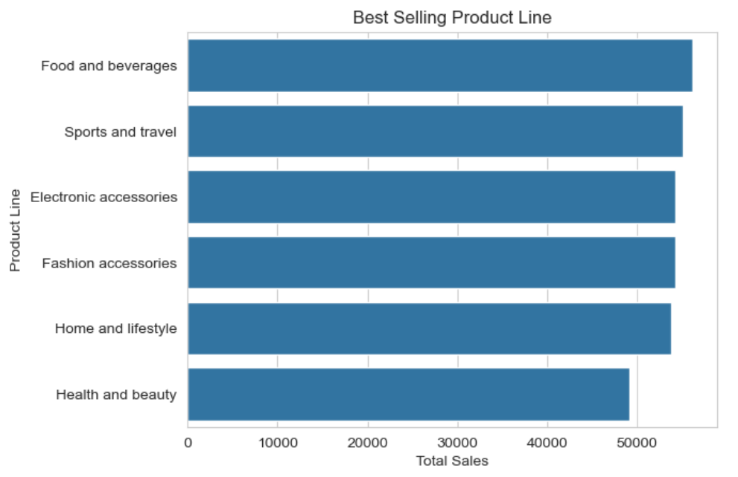
Best-Selling Product Analysis :
Grouped sales data by product line to measure category-wise revenue.
Compared total revenue generated by each product category.
Identified the highest-performing product line.
Product-level analysis helps optimize inventory and marketing strategies.

Slide 10
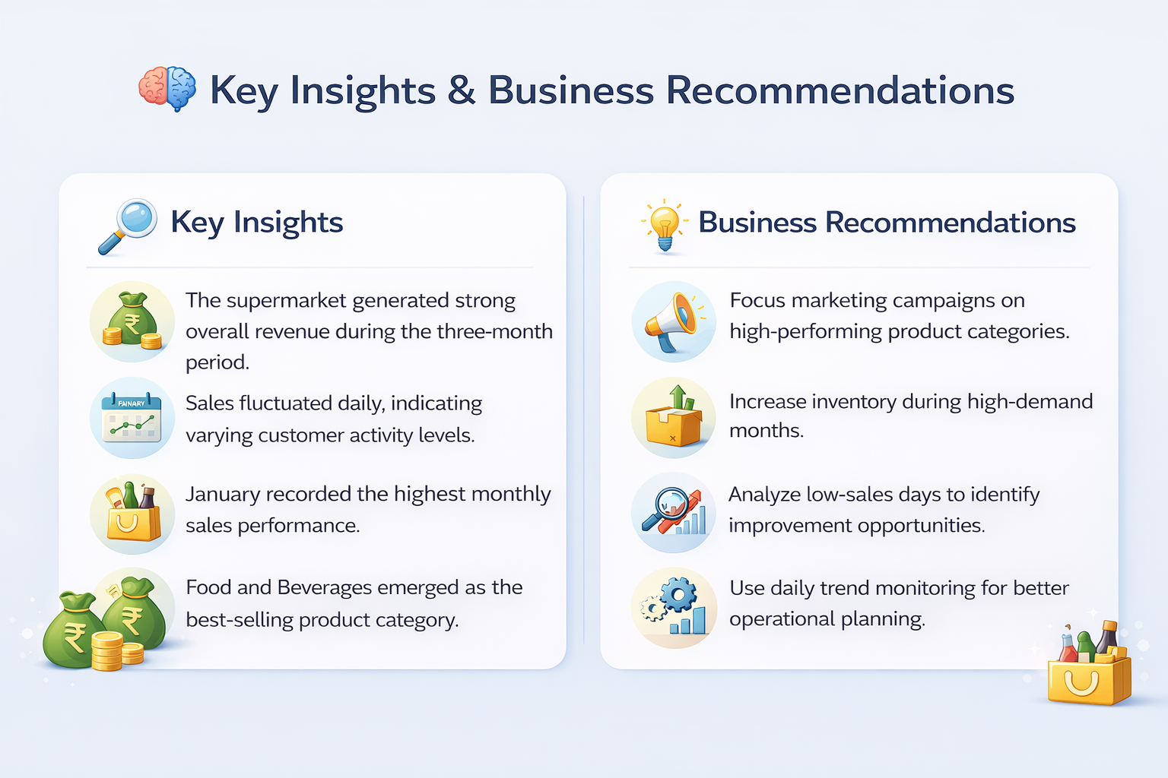

Slide 11
Conclusion
Conclusion: “Turning Data into Decisions.”
Data analysis helps businesses make informed and strategic decisions.
Visualizing trends improves understanding of performance patterns.
Data-driven planning increases profitability and operational efficiency.

Slide 12
THANK YOU !

